Slide 1

Mohamed Ayman Afifi
10 / 12 / 2025
Mohamed Ayman Afifi
10 / 12 / 2025

Slide 2
Problem Description
Lending companies face significant challenges when assessing the creditworthiness of customers, especially those with limited or no credit history. Without clear insights into a customer’s financial behaviour, institutions risk either approving loans to high-risk borrowers or rejecting reliable clients.
Both scenarios negatively impact business performance and financial stability.

Slide 3
Overview of the Proposed Solution
The project uses Exploratory Data Analysis to study customer demographics, financial profile & historical behaviour to uncover patterns related to loan defaults. By analyzing key features (such as loan history, credit behaviour & repayment patterns) the solution identifies the factors that associates strongly with default risk
These Insights help organizations make data driven decisions on loan approval, risk classification & policy adjustments

Slide 4
End Users
For this problem, the key end users are:
Loan Officers & Credit Analysts: Responsible for reviewing applications and deciding who gets approved
Risk Management Teams: Focus on identifying high-risk customers and reducing default rates.
Business Managers & Executives: Need insights to adjust lending policies, interest rates, and business strategies.

Slide 5
DataSet Overview
Dataset Source: Kaggle – Loan Defaulter Dataset
The dataset consists of two tables:
1. Previous Application Data: 37 features Containing information about the client’s previous loan applications, including:
Customer demographics (age, gender, occupation)
Loan performance & repayment history
Credit behaviour and previous loan outcomes
Purpose: Analyse past patterns and identify risk factors for defaults

Slide 6
DataSet Overview
2. Application Data :
122 features Containing client information at the time of loan application, including whether the client has payment difficulties.
Also Includes:
Customer demographics & financial attributes
Employment information & existing debts
Requested loan details and terms
Purpose: Evaluate new applications and predict likelihood of default

Slide 7
Tools Used for the project
Programming Language:
Python, core language for data analysis, visualization, and model development
Data Processing & Analysis:
Pandas & Numpy for data cleaning, manipulation, and exploration
Data Visualization:
Matplotlib for creating charts and plots
Seaborn for statistical visualizations for deeper insights

Slide 8
Project Development Methodologies:
Data Cleaning & Preprocessing

Slide 9
1. Data Understanding
Explored the dataset structure, feature types, and distributions
Identified key variables influencing loan defaults
Analyzed relationships between customer behaviour and loan outcomes

Slide 10
2. Data Cleaning
Removed inconsistent entries, duplicates & invalid records
Standardized data formats
Ensured that the dataset is reliable and ready for analysis & modeling

Slide 11
3. Feature Engineering
Created meaningful new features from existing data
Transformed variables to improve model learning

Slide 12
4. Handling Nulls & Outliers
Treated missing values through appropriate imputation techniques
Detected and managed extreme values that could disort the model
Ensured data quality for reliable & stable model performance

Slide 13
Project Development Methodologies:
Exploratory Data Analysis

Slide 14
EDA Steps
After cleaning the dataset, we performed a series of EDA steps to understand patterns, detect trends, and extract meaningful insights:
Univariate Analysis: Examined individual features (income, age, loan amount, credit score).
Bivariate Analysis: Compared key features with the target variable (loan default).
Correlation Analysis: Generated a correlation matrix and heatmap to detect strong relationships between numerical features.

Slide 15
EDA Steps
Outlier Behavior & Distribution Checks: Evaluated variable ranges using boxplots and statistical metrics.
Categorical Feature Exploration: Analyzed categories such as education, occupation, marital status, and housing type.

Slide 16
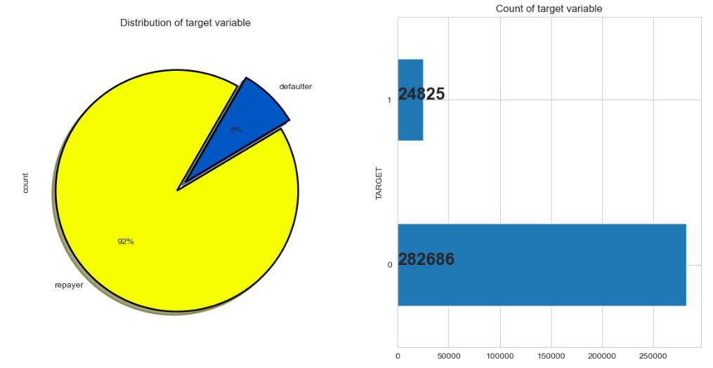
Top Insights

Slide 17
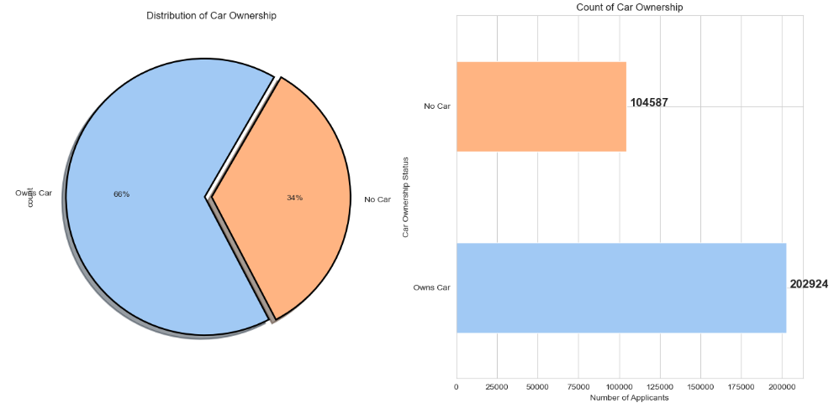
Top Insights

Slide 18
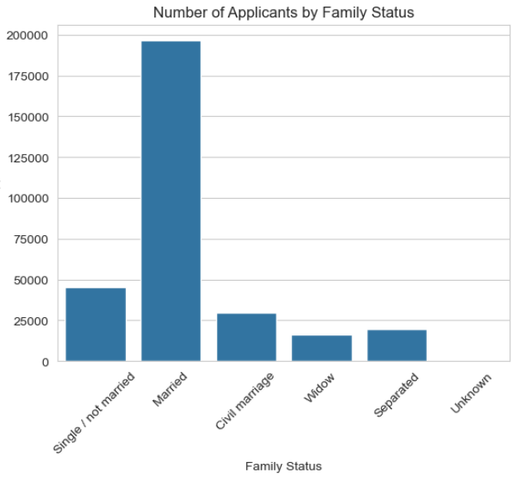
Top Insights

Slide 19
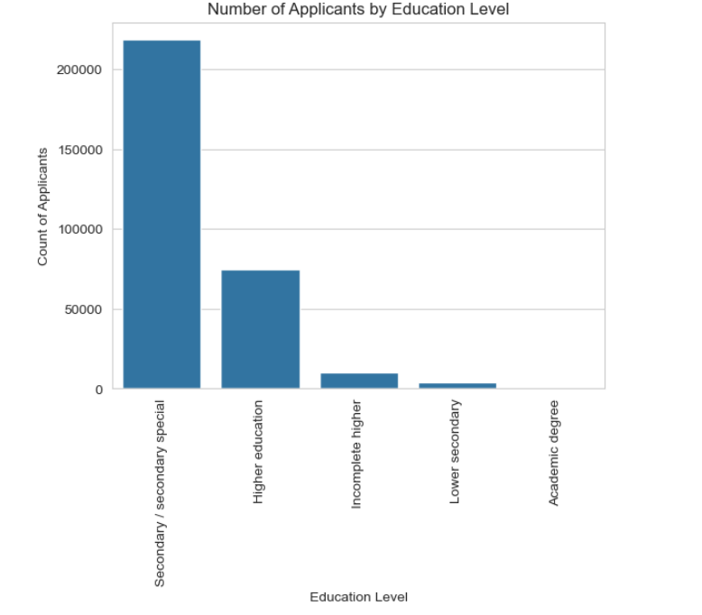
Top Insights

Slide 20
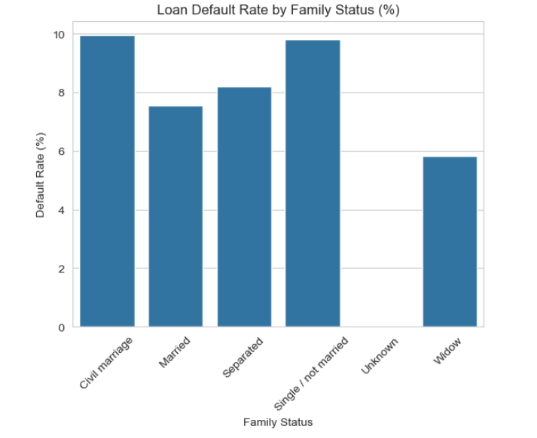
Top Insights

Slide 21
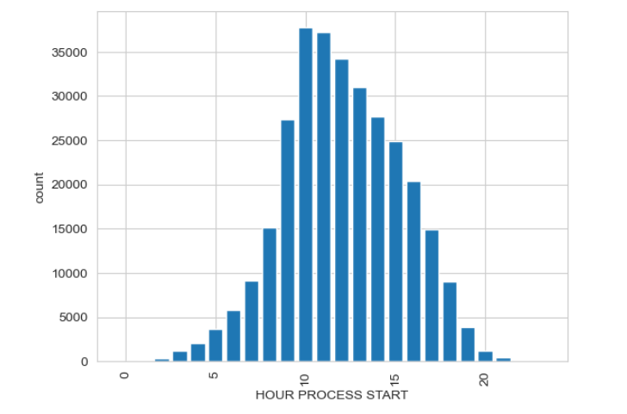
Top Insights

Slide 22
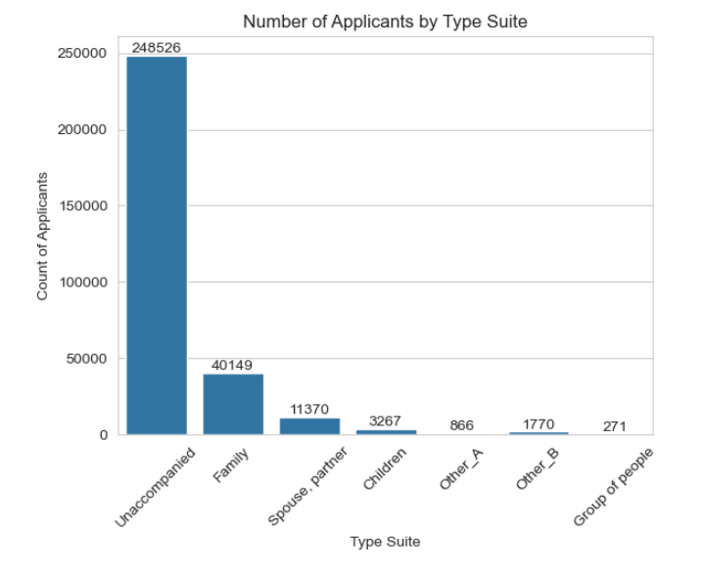
Top Insights

Slide 23
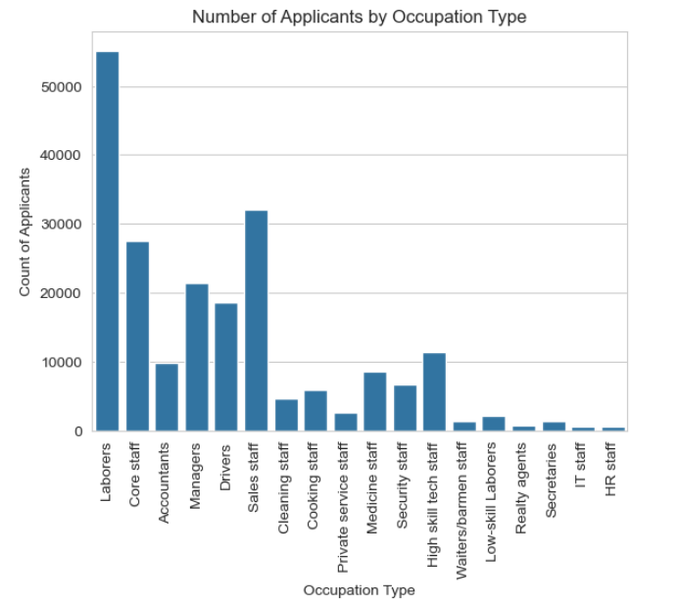
Top Insights

Slide 24
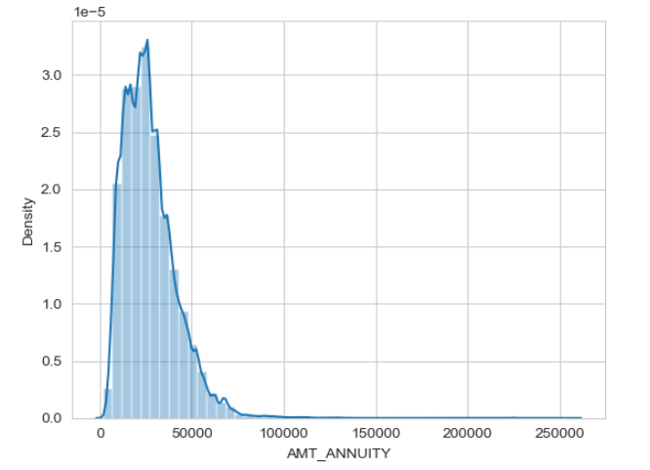
Top Insights

Slide 25
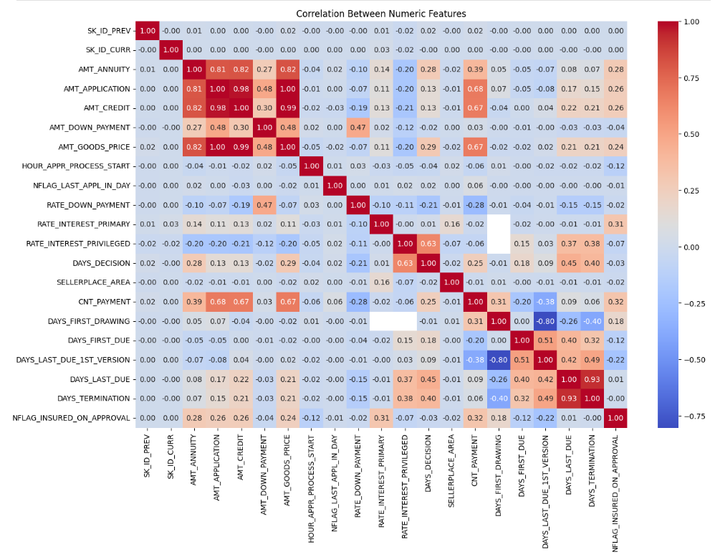
Top Insights

Slide 26
Project Development Methodologies:
Data Modeling

Slide 27
Model Selection
To identify the most effective model for predicting loan defaults,
we trained and evaluated three machine learning algorithms:
CatBoost Classifier
Random Forest Classifier
LightGBM Classifier

Slide 28
5.1. CatBoost
Accuracy Score: 81%
ROC AUC Score: 96.7%

Slide 29
5.1. CatBoost
Summary of Classification Results:
Class 0 (Non-Defaulters): Good precision (96%) but low recall (68%), the model missed many non-defaulters.
Class 1 (Defaulters): Moderate precision (70%) but very high recall (96%), the model correctly identified most defaulters but misclassified many non-defaulters as risky.
Interpretation: CatBoost struggled with balancing both classes and produced many false positives.

Slide 30
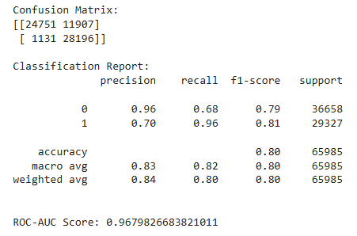
5.1. CatBoost

Slide 31
5.2. Random Forests
Strong but Slightly Overfitted
Train Accuracy of 99%
Test Accuracy: ~94% (clear sign of slight overfitting)

Slide 32
5.2. Random Forests
Summary of Classification Results:
Class 0: Very high recall (99%) and strong precision (91%), rarely misses non-defaulters.
Class 1: Excellent precision (99%) but lower recall (87%),
identifies risky customers accurately but misses some actual defaulters.
Interpretation: Random Forest performed well but showed signs of memorizing the training data, reducing generalization.

Slide 33
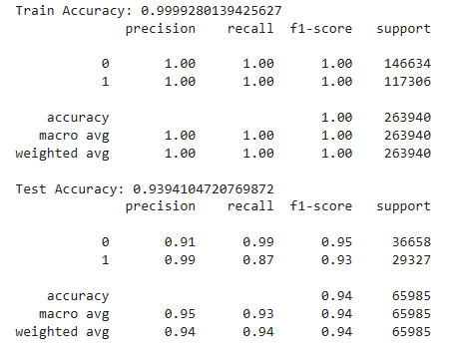
5.2. Random Forests

Slide 34
5.3. LightGBM
Best Overall Model
Train Accuracy: 95%
Test Accuracy: 94.5%
ROC AUC: 97%

Slide 35
5.3. LightGBM
Key Highlights:
- Precision = 1.00 for Class 1 (Defaulters): The model made zero false-positive predictions for defaulters.
- Recall = 1.00 for Class 0 (Non-Defaulters): The model made zero false-negative predictions for non-defaulters.
Interpretation: LightGBM provided the best balance, highest reliability, and the strongest ability to correctly classify both safe and risky customers with minimal errors.

Slide 36
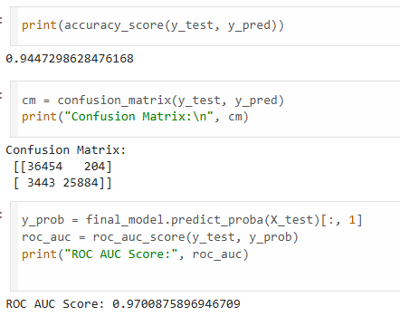
5.3. LightGBM

Slide 37
Application Overview

Slide 38

Deployment
Deployed using Flask framework for a full web interface and Streamlit for quick testing and prototyping.
Integrated with chatbot that can interact with users, answers their questions and handle loan application data.

Slide 39
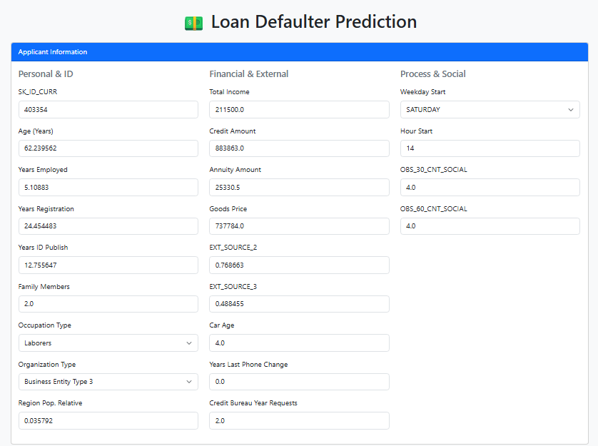
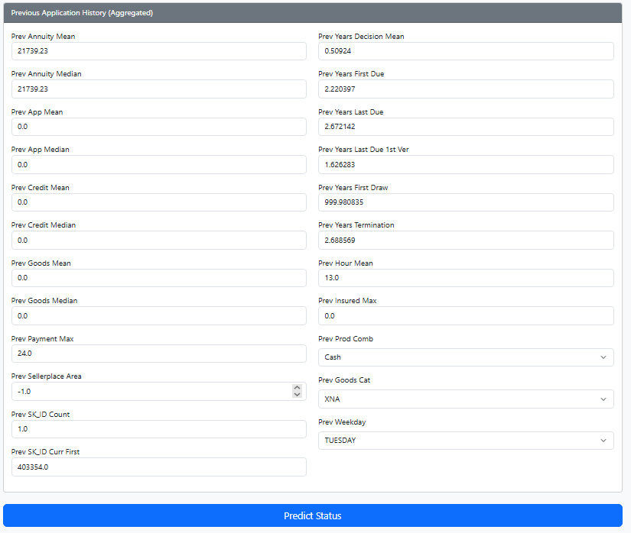
1. Flask Deployment
1.1. Applicant Information
1.2. Previous Application History

Slide 40
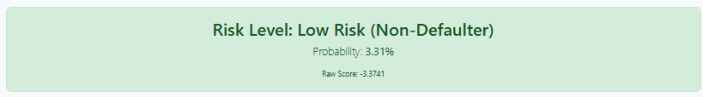
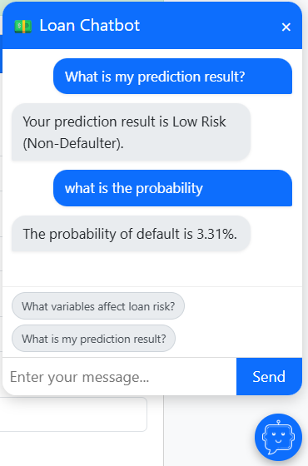
1. Flask Deployment
1.3. Prediction Result
1.4. Chatbot

Slide 41
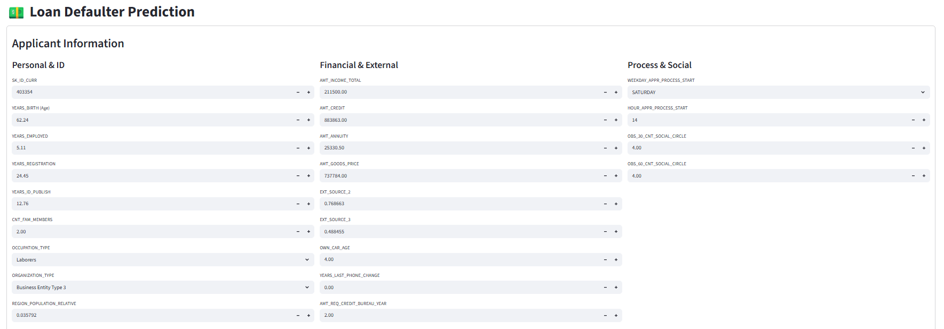
2. Streamlit Deployment
2.1. Applicant Information

Slide 42
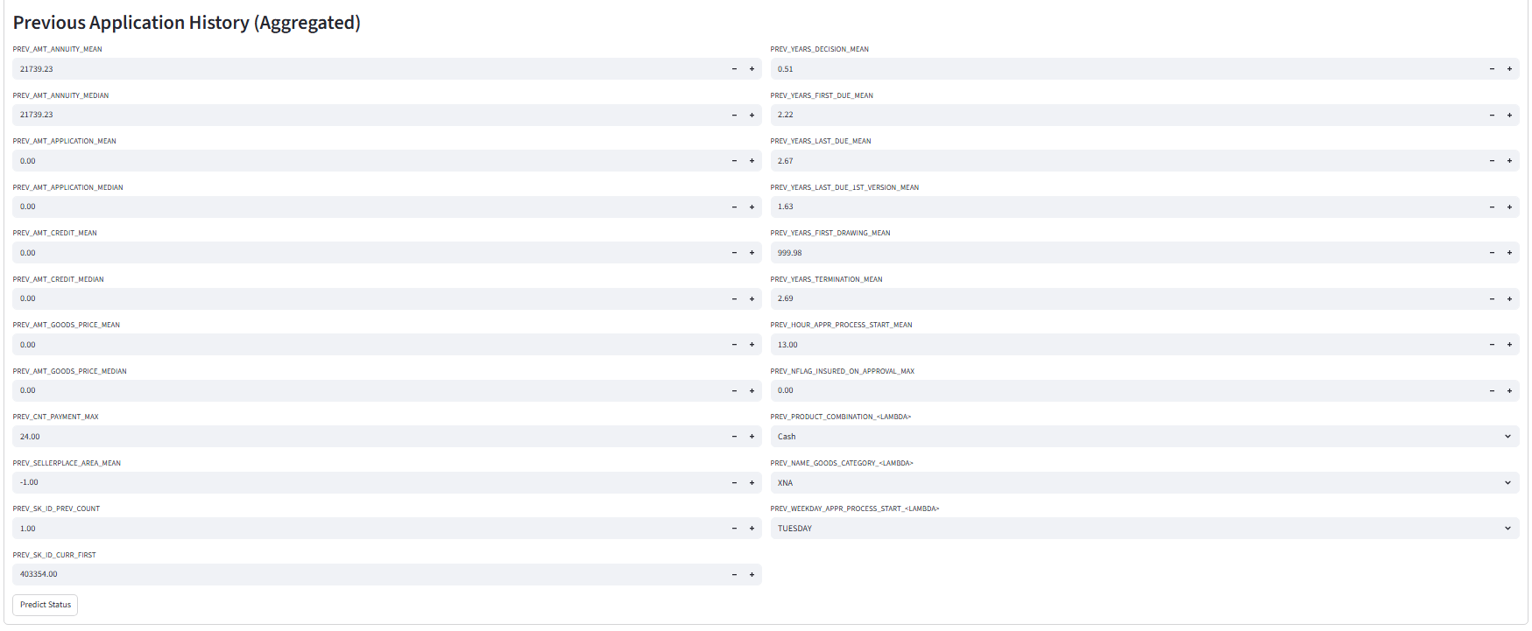
2. Streamlit Deployment
2.2. Previous Application History

Slide 43
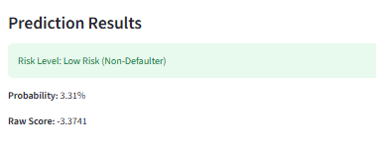
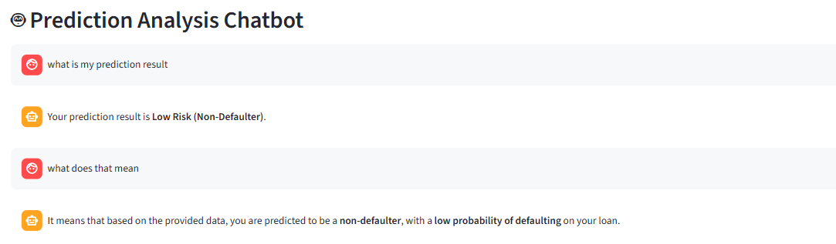
2. Streamlit Deployment
2.4. Chatbot
2.3. Prediction Result

Slide 44
What did our team do:
Team Member | Main Accomplishments
Mohammed Yasser Ismael | Data Cleaning, Handling Data Inconsistencies, LightGBM Classifier Model, Feature Selection, Final Presentation
Noureldin Mohammed Amin | Handling Outliers, Application Chatbot, Project Documentation, Final Presentation
Abdelrahman Hassan Shaaban | Project Kick-Start Documentation, Data Exploration, EDA For Application DataSet, Streamlit Application, Flask Application, Model Deployment
Mohamed Ayman Afifi | Feature Engineering, Random Forests Classifier Model, Project Description
Mark Hany Adel | EDA For Previous DataSet, CatBoost Classifier Model

Slide 45


